Slide 1
Python Dictionary

Slide 2
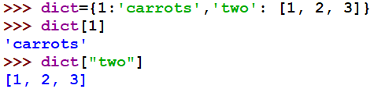
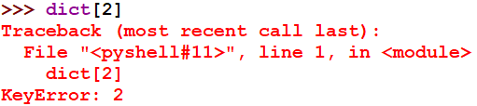


Accessing a Dictionary
Accessing a value: A Python dictionary is unordered. So to get a value from it, we need to put its key in square brackets.
get(): get() method takes a key as an argument and returns the corresponding value.

Slide 3


Reassigning a Dictionary
The python dictionary is mutable. This means that we can change it or add new items without having to reassign all of it.
Updating the value of an existing key:
Adding a new key:

Slide 4
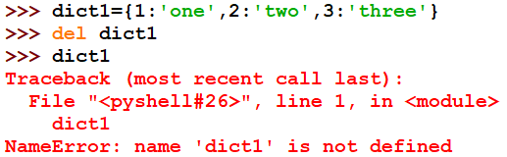

Delete a Dictionary
Deleting an entire dictionary:
Deleting a single key-value pair:

Slide 5
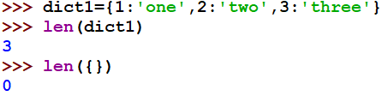
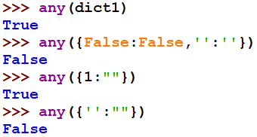
In-Built Functions
len(): It returns the length of the dictionary.
any(): It returns True if even one key in a dictionary has a Boolean value of True.

Slide 6
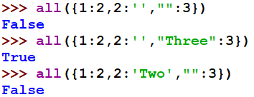
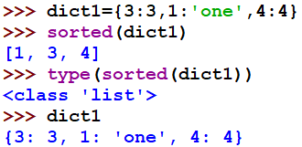
In-Built Functions
all(): It returns True only if all the keys in the dictionary have a Boolean value of True.
sorted(): It returns a sorted sequence of the keys in the dictionary.

Slide 7


In-Built Methods
keys(): It returns a list of keys in a dictionary.
values(): It returns a list of values in the dictionary.
items(): It returns a list of key-value pairs.

Slide 8
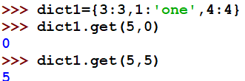

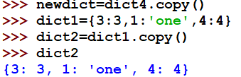
In-Built Methods
get(): It takes one to two arguments. While the first is the key to search for, the second is the value to return if the key isn’t found.
clear(): It empties the dictionary.
copy(): It creates a shallow copy of the dictionary.

Slide 9
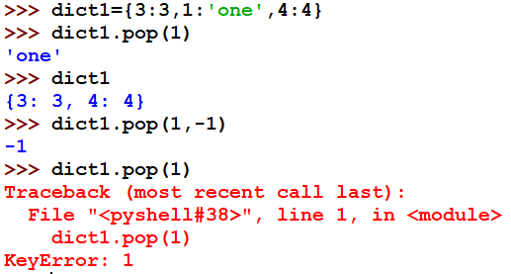
In-Built Methods
Pop():This method is used to remove and display an item from the dictionary. It takes one to two arguments. The first is the key to be deleted, while the second is the value that’s returned if the key isn’t found.

Slide 10
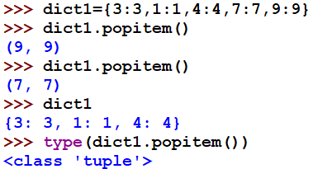
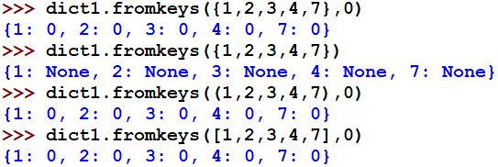
In-Built Methods
popitem():
fromkeys():

Slide 11
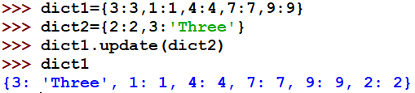
In-Built Methods
update():

Slide 12

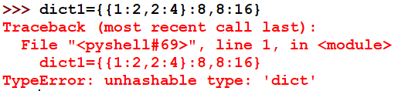
Nested Dictionary
We can also place a Python dictionary as a value within a dictionary.

